Slide 1
TASK 2: REQUIREMENT GATHERING
Table of contents;
Stakeholder identification
Requirement gathering techniques
Data gathering
Data cleaning
User reluctance assessment
PRESENTED BY
EBAN BORIS MANYO
AKAWUNG GABRIEL
NYENTY OBI R.
IKOME M.B JOHNSON
COURSE INSTRUCTOR: DR VALERY NKEMENI
COURSE TITLE: INTERNET PROGRAMING & MOBILE PROGRAMING
COURSE CODE: CEB402

Slide 2
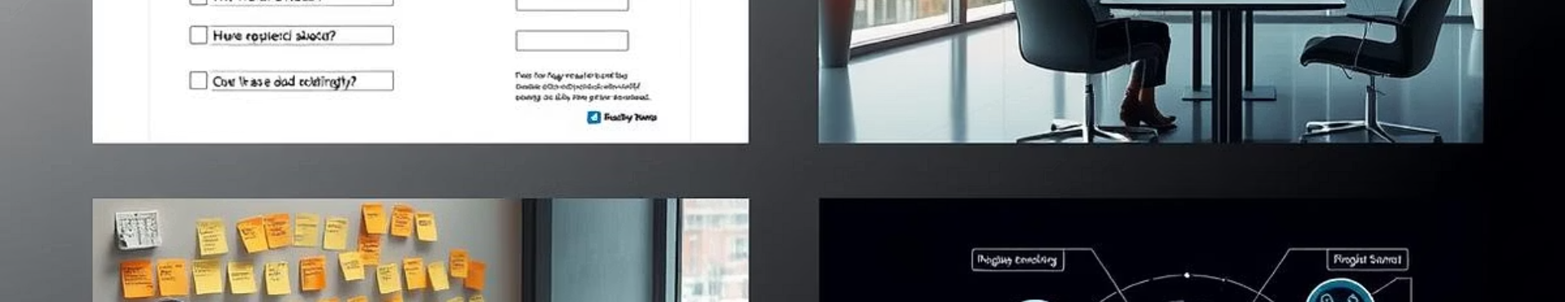
Requirements Gathering : Disaster Management App
“In times of crisis, every second counts — and so does every decision. But what if the success of a disaster response effort hinges not only on technology, but on the voices we choose to hear from the very beginning?”
Today, I’m presenting a concept that bridges emergency response and smart planning: a Disaster Management App designed to save lives through informed action. But before the first line of code is written, before a single alert is sent — we must listen.
That’s where stakeholder identification and requirement gathering come in.
In this presentation, I’ll walk you through how we pinpoint the people who matter most, collect the right insights, and lay a strong foundation for a tool that could change how we respond to disasters — not just with urgency, but with precision.
ij
Presented by Group 1

Slide 3
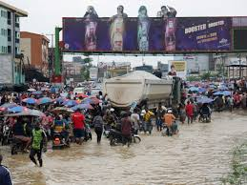


Stakeholder Identification: A Comprehensive Approach
We started by mapping key stakeholder groups and individuals. Strategies were used to identify less obvious stakeholders. We prioritized inclusivity to capture diverse perspectives from community leaders to emergency responders.
Initial Mapping
Hidden Stakeholders
Primary stakeholders: NGO Worker, Disaster Victims, Firefighters
Technology providers, Regulatories bodies, investors and funders.

Slide 4





Requirement Gathering Techniques: A Multi-Faceted Strategy
A combination of methods was used: surveys for broad data, interviews for deep insights. Brainstorming generated creative solutions. Reverse engineering analyzed existing systems.
Surveys
Interviews
Brainstorming
Reverse Engineering

Slide 5
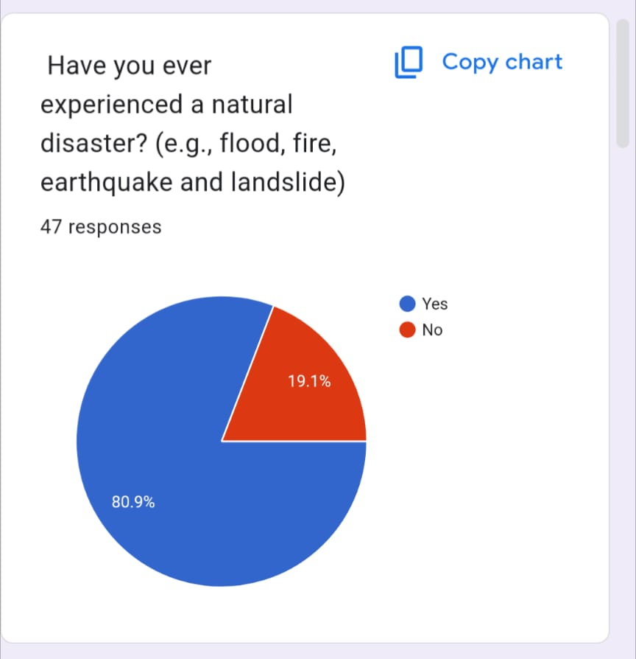
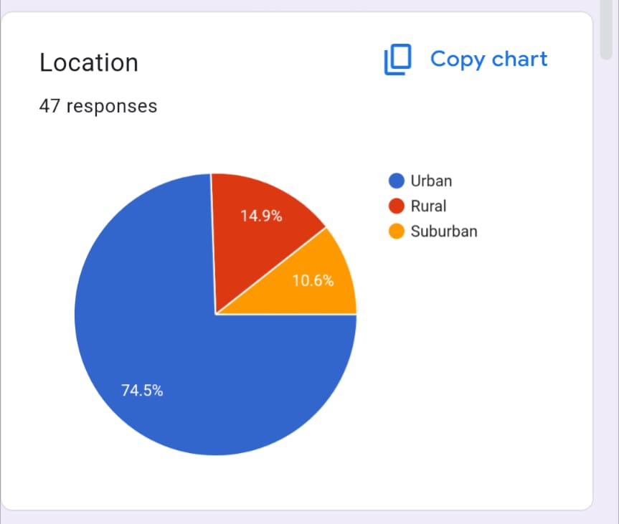
Surveys: Quantifying User Needs and Preferences
Surveys helped quantify user needs through clear, concise questions. Effective distribution channels maximized response rates. Data analysis revealed key trends, like 85% prioritization of real-time alerts.

Slide 6
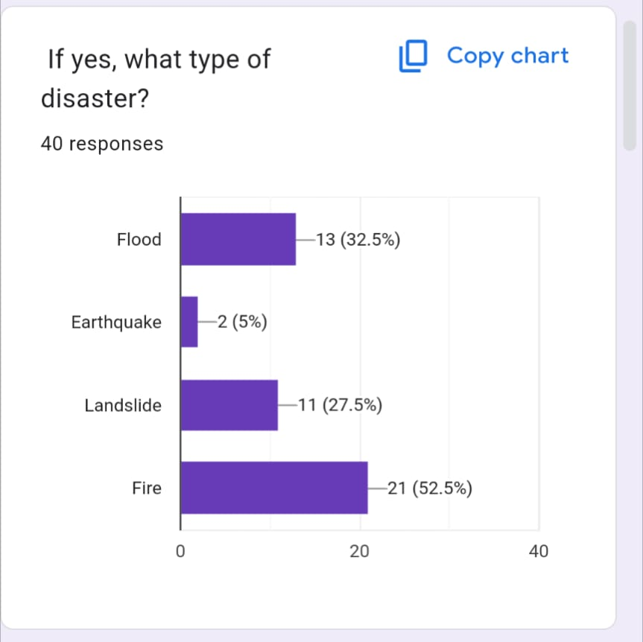
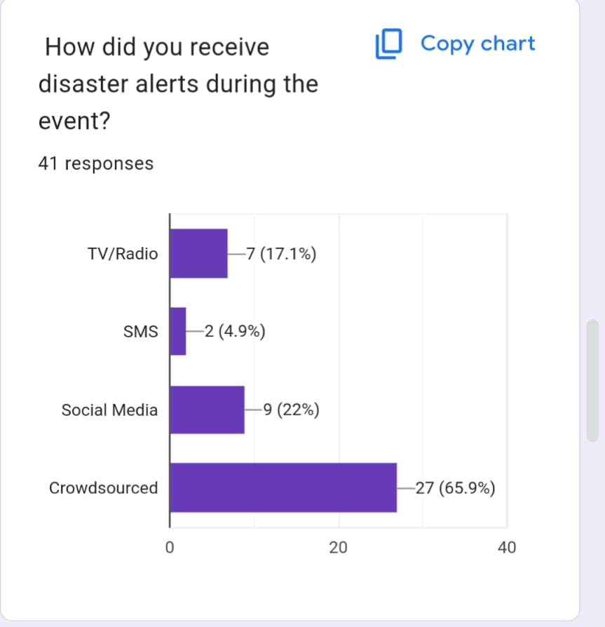
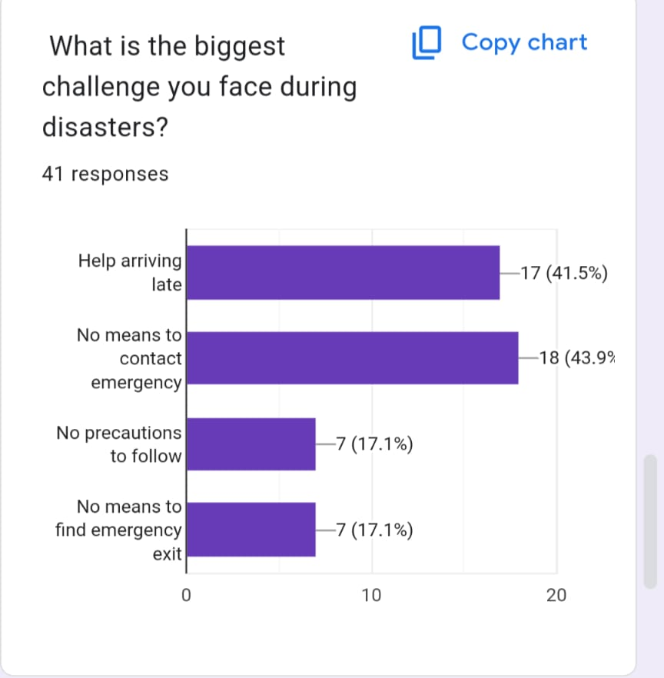

Slide 7
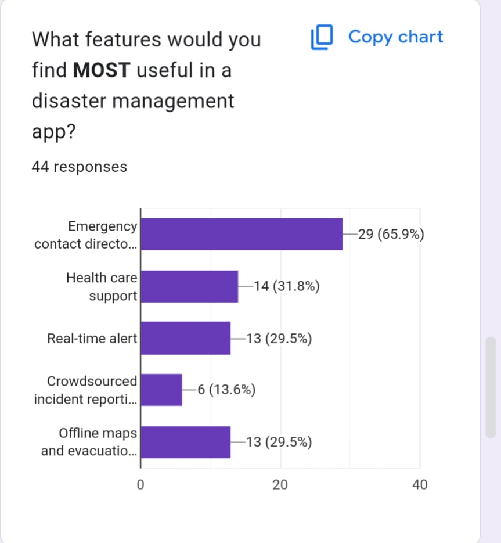
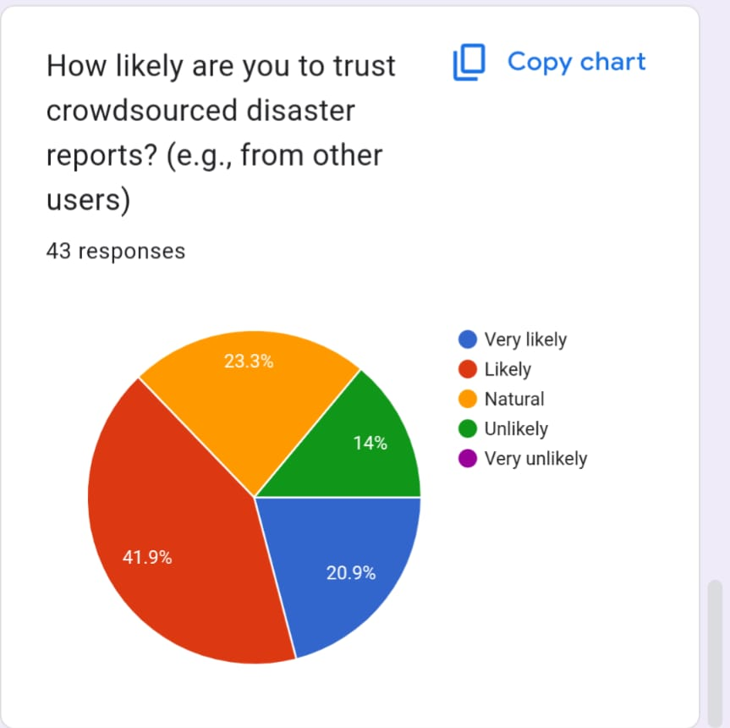
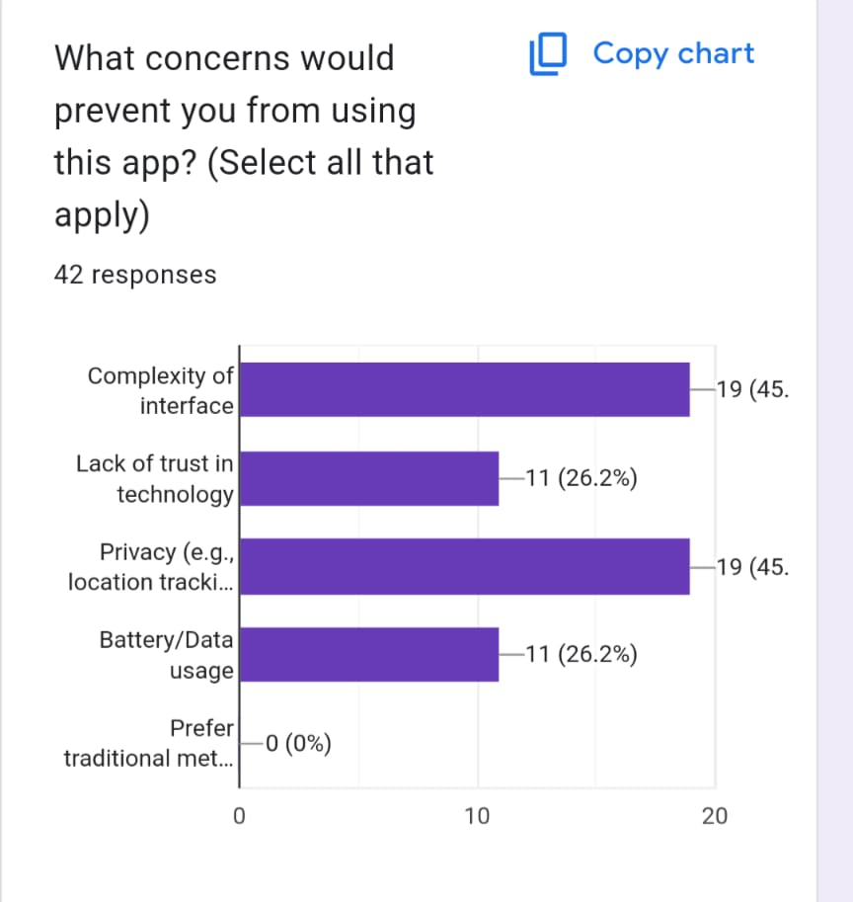

Slide 8
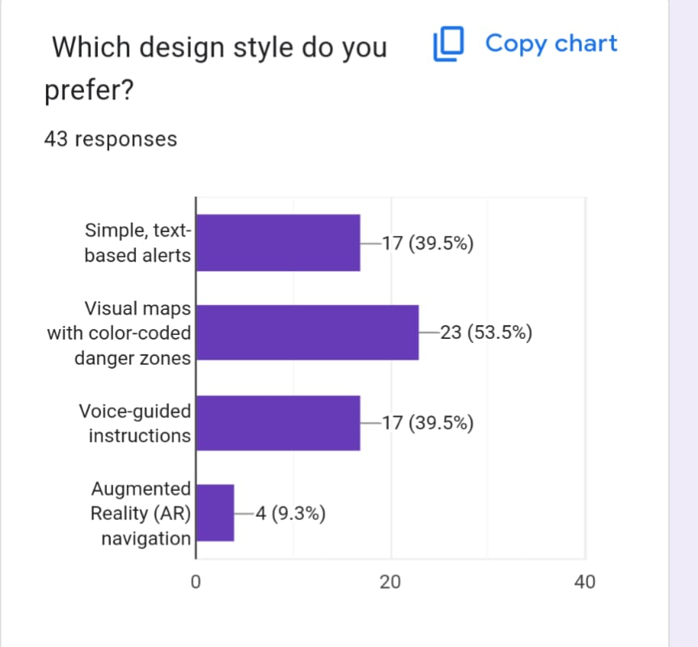
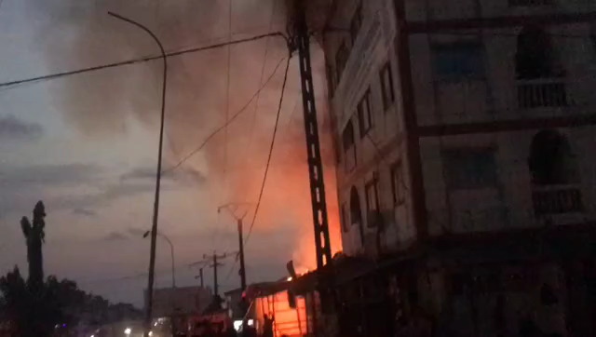

Slide 9
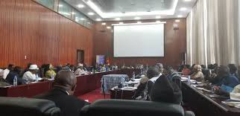
Interviews: Deep Dives into User Perspectives
Interview with the Chief of Liwu la Malale (CHIEF EKWA)
What would stop your community from using a disaster app?
“HE RESPONSE MANY ELDER’S HERE DON’T OWN SMARTPHONES. EVEN IF THEY DID,THEY WILL TRUST A NEIGHBOR’S WARNING OVER A MACHINE BUT IF THE APP COULD SEND SMS IN OUR LOCAL LANGUAGE THAT MIGHT WORK.

Slide 10
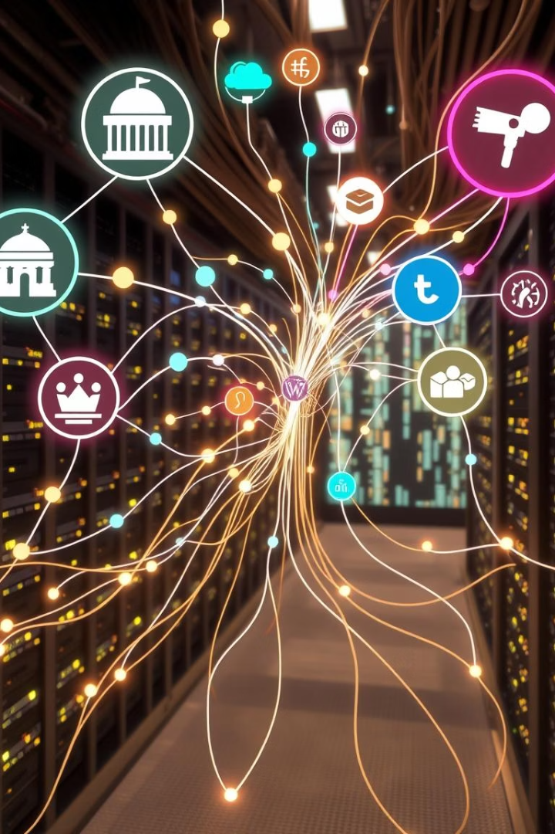
Data Gathering: Sources and Strategies
We identified relevant data sources like Survey and APIs. Data quality assessment and validation procedures were implemented. Data integration and management strategies were defined. Real-time weather and evacuation routes are available.
Source Identification
Quality Assessment
Survey
Data Validation
Public APIs
Quality Control
Integration
Data Management
Unified System

Slide 11



Data Cleaning and Preparation: Ensuring Accuracy
Inconsistencies and errors were addressed through cleaning. Data formats were standardized for analysis. Data validation and quality control measures were enforced. Specialized tools aided cleaning.
2
Standardize Formats
1
Address Inconsistencies
Enforce Validation
3

Slide 12
User Reluctance Assessment: Overcoming Barriers
Potential sources of user reluctance included privacy and complexity. We addressed concerns and built trust through transparency. User training and support initiatives were developed. Data encryption addressed privacy concerns.
Identify Concerns
Build Trust
Privacy & complexity.
Transparency & education.

Slide 13
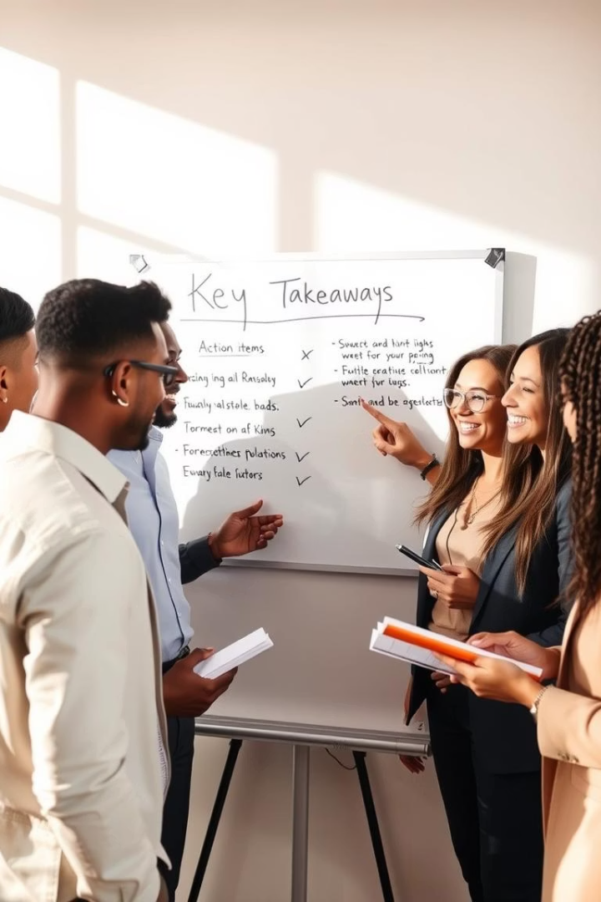



Key Takeaways and Future Considerations
Lessons learned will optimize future efforts. Next steps include transitioning to design and development. We acknowledge team contributions to our success.
Lessons Learned
Next Steps
Optimizing future efforts.
Transition to design.
Celebrate Successes
Acknowledge team.

